Slide 1

Data Stream Clustering
Identifying Structure from Sensor Data
Notes:
הצגה

Slide 2
Background
Survey:
Carnein, M., Trautmann, H. Optimizing Data Stream Representation: An Extensive Survey on Stream Clustering Algorithms. Bus Inf Syst Eng 61, 277–297 (2019).
link
Notes:
מאמר סקירה
51 אלגוריתמים
מכנה משותף

Slide 3
Data Stream Clustering
Data stream clustering is applicable for all streamed data. Some examples are:
Sensor data
Social media streams
Stock market data
Key features are:
Data is gathered incrementally thus pre-processing and clustering should be incremental as well.
Data stream is potentially infinite, and therfore the system must discard data and maintain only an aggregate, or utilize windowing
Data might be non-stationary.
Notes:
שימושים:
סנסור
רשת חברתית
מניות
מאפיינים
דאטא נצבר לאט
אינסוף דאטא
לא סטציונארי

Slide 4
Main Challenges
Cluster data to gain knowledge while discarding old irrelevant raw data, due to storage limitations.
Maintain enough knowledge regarding discraded data, so that clustering can be refined as new data arrives.
Build a machanism to discard / reassess old clusters, in order to detect transient phenomena. Some algorithms use several time scales for this.
Incremental processing is imporatant due to computational limitations, as clustering at least in part isn’t done in post processing.
Notes:
אתגרים:
אשכול עם דאטא חלקי
צמצום מידע, שמירת מה שרלוונטי
תופעות מעבר
incremental

Slide 5
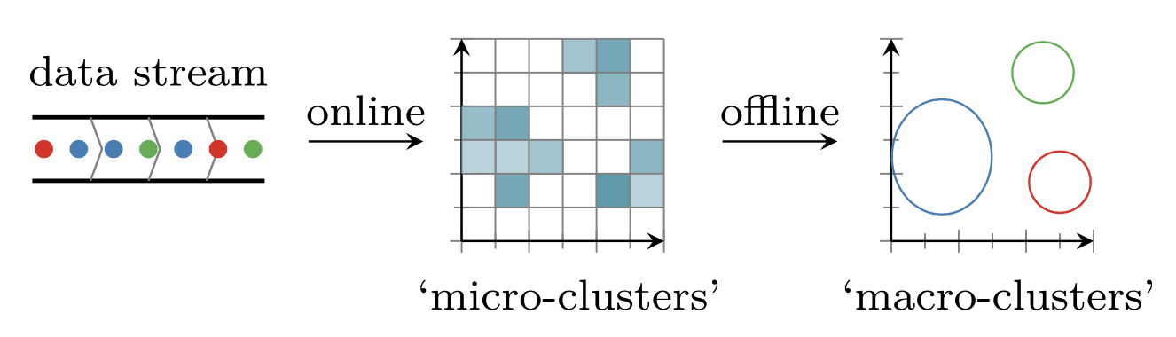
Two – Phase Clustering
As discussed in classes, clustering algorithms tend to employ an iterative procedure to refine their results, optimize the number of clusters, etc.
The real time nature of data stream clustering algorhitms may prohibit this.
A solution is to utilize a first phase step to create micro-clusters, and then, either periodaically, or in post processing, run a second step to iterate in re-cluster the results.
Notes:
שני שלבים

Slide 6
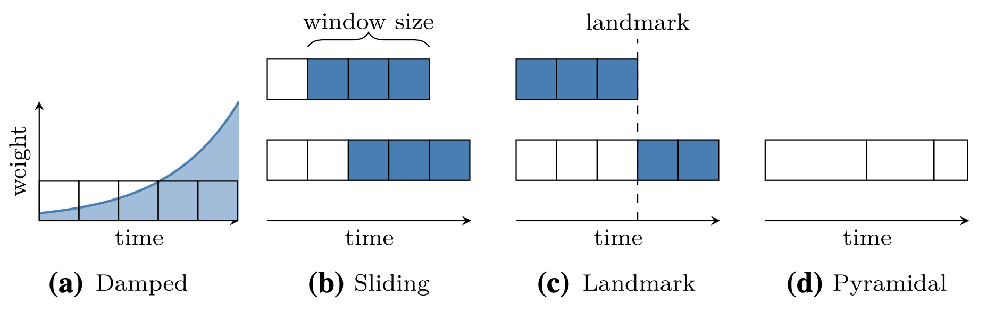
Time Window Models
Time window models help the system “forget” old data and help perforamnce when dealing with non-stationary processess.
General model types:
Damped – older samples have smaller weights.
Sliding Window – retain only recent samples. Window may have a varyaible length.
Landmark Time Window – Use any data based or external landmark to define windows.
Pyramidal Time Model – Use several time windows of diffrerent length to obtain diffrennt level of granulatiry.
Notes:
חלונות זמן

Slide 7
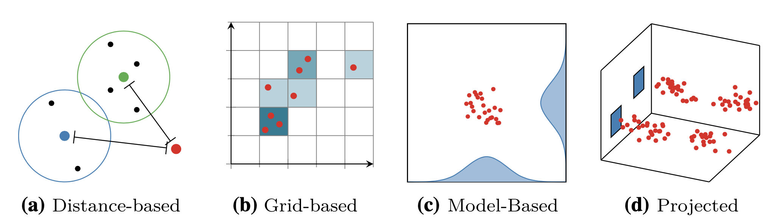
Common Strategies
Strategies are divided as:
Distance based - clusteres are created according to a distance threshold.
Grid based – break down the sample space to a grid and maintain only the population density.
Model based – Fit data to a model, and discard samples.
Projection – Project samples to a lower dimension.
Notes:
גישות

Slide 8
Distance Based Algorithms

Slide 9
Distance Based Algorithms
Distance-based algorithms are the most common and popular approaches in stream clustering.
However, they rely on many parameters, and thus making them work given specific data may be challenging.
Another limitation is that their reliance on a distance measure, makes them more susceptible to forming clusters of certain shapes, depending on the used metric.
Notes:
נפוצים
הרבה פרמטרים
תלוי בפונקציית מרחק

Slide 10
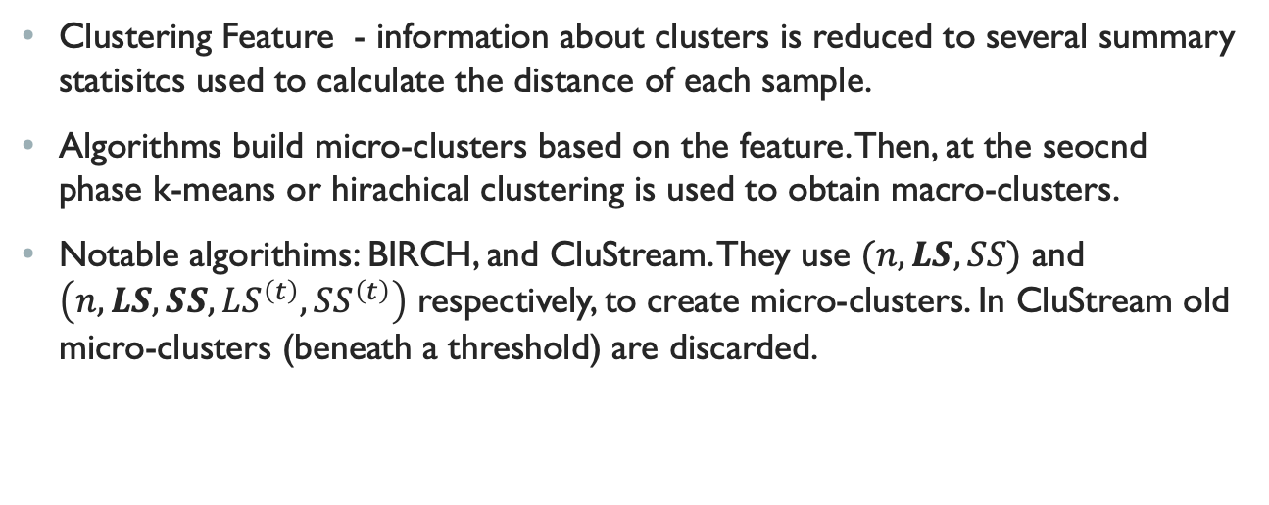
Distance Based Algorithms - Clustering Feature
Clustering Feature - information about clusters is reduced to several summary statisitcs used to calculate the distance of each sample.
Algorithms build micro-clusters based on the feature. Then, at the seocnd phase k-means or hirachical clustering is used to obtain macro-clusters.
Notable algorithims: BIRCH, and CluStream. They use $(n, LS,SS)$ and $\left(n, LS,SS,LS^{\left(t\right)},SS^{\left(t\right)}\right)$ respectively, to create micro-clusters. In CluStream old micro-clusters (beneath a threshold) are discarded.
Zhang, T., Ramakrishnan, R. & Livny, M. BIRCH: A New Data Clustering Algorithm and Its Applications. Data Mining and Knowledge Discovery 1, 141–182 (1997).
Aggarwal, Charu C., et al. "A framework for clustering evolving data streams." Proceedings 2003 VLDB conference. Morgan Kaufmann, 2003.
Notes:
N – number of samples
LS – linear sum (vector) of samples
SS – sum of squares of all entries
LS^t – linear sum of time stamps
SS^t – squared sum of time stamps

Slide 11
Distance Based Algorithms – Time Faded Clustering Feature
These algorithms add a time decaying weight to observations, thus allowing old micro-clusters to lose significance.
A noteable algorithim is DenStream. The algorithm initializes several potential core micro-clusters.
New samples are then attached to these if their distance isn’t too large, or else they form new outlier micro-clusters.
Promotion of outliers and degradation of cores happens according to thier decaying weight.
Cao, Feng, et al. "Density-based clustering over an evolving data stream with noise." Proceedings of the 2006 SIAM international conference on data mining. Society for industrial and applied mathematics, 2006.
Notes:
מוסיפים: decay לold clusters
יש הבחנה בין קלסטרים core ו outliers
מעבר לפי משקל

Slide 12
Distance Based Algorithms – Competitive Learning
A recent type of of algorithims incorporate comptetive learning into the time decaying features-based algorithms.
Following, clusters move their centers towards the absorbing cluster, in order to ”compete” for the sample. If they get too close, they merge.
A notable alogorithm of this type is SOStream.
Isaksson, Charlie, Margaret H. Dunham, and Michael Hahsler. "SOStream: Self organizing density-based clustering over data stream." International Workshop on Machine Learning and Data Mining in Pattern Recognition. Springer, Berlin, Heidelberg, 2012.
Notes:
מרכזים מנסים להתקרב. לנקודות.
עוד בהמשך.

Slide 13
Grid Based Algorithms
Notes:
משפחה שנייה

Slide 14
Grid Based Algorithms
Grid based algorithms attempt to capture the density of observations in a grid.
A grid separates the data space along all dimensions into intervals to create grid-cells.
By mapping data points to the cells, a density estimate can be maintained.
Macro-clusters are typically found by grouping adjacent dense cells.
Notes:
בונים grid וסופרים צפיפות.
ממפים דגימה לצפיפות.
אחרי זה עושים clustering על צפיפות.

Slide 15
Grid Based Algorithms
Grid based algorithms natively support arbitrarily shaped clusters, depending on the post processing scheme.
The need to hold the grid in memory implies a higher memory footprint, in comparison with distance-based algorithms.
The most prominent algorithm is D-Stream, which utilizes a fixed grid, but there are alternatives which use recursive partitioning.
Notes:
תמיכה מובנית בצורות שונות.
צריך להחזיק את כל ה-grid , עלול להיות תובעני מבחינת זיכרון
רשת בועה או אדפטיבית או רקורסיה.

Slide 16
D-Stream
The algorithm distinguishes between three types of cells: dense cells, sparse cells and transitional cells whose weight lies between the other two types.
The algorithm maps new data points to its respective cell and is initialized by assigning all dense cells to individual clusters.
These clusters are extended with all neighboring transitional cells or are merged with the clusters of neighboring dense cells.
In regular intervals, the clustering evaluates the weight of each cell and incorporates the changes in cell types into the clustering.
Chen, Yixin, and Li Tu. "Density-based clustering for real-time stream data." Proceedings of the 13th ACM SIGKDD international conference on Knowledge discovery and data mining. 2007.
Notes:
מבחין בין סוגים שונים של צפיפות: צפוף, לא צפוף או באמצע.
מגדילים אותם.

Slide 17
evostream
Carnein, Matthias, and Heike Trautmann. "evostream–evolutionary stream clustering utilizing idle times." Big data research 14 (2018): 101-111.
link

Slide 18
evoStream
evoStream is an evolutionary algorithm for clustering data streams.
Instead of using the standard two-phase mechanism of standard algorithms, evoStream uses and evolutionalry algorithm to incrementally improve its assessment regarding macro-clusters.
Evolution is done in between arrivals of new samples.
The online component is forms time decaying micro-clusters from samples.
Notes:
אלגוריתם אבולוציוני
אין שני שלבים – incremental
לא צריך post processing.

Slide 19
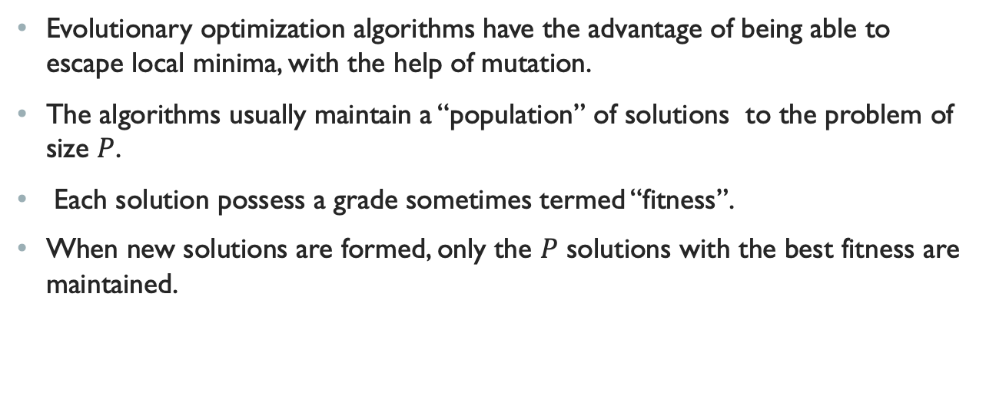
Evolutionary Algorithms - #1
Evolutionary optimization algorithms have the advantage of being able to escape local minima, with the help of mutation.
The algorithms usually maintain a “population” of solutions to the problem of size $P$.
Each solution possess a grade sometimes termed “fitness”.
When new solutions are formed, only the $P$ solutions with the best fitness are maintained.
Notes:
אוכלוסיה, שרידות,

Slide 20
Evolutionary Algorithms - #2
At each evolutionary step, some members of the population (algorithm specific), are chosen to create “offspring” solutions.
These offspring solutions hope to receive good qualities from their parents, to produce better fitness.
At the heart of the algorithm is the mutation process.
The mutation process changes some some features of the offspring with pre-determined mutation probability.
The mutation helps the algorithm escape local extrema.
Notes:
ילודה,
מיזוג גנים
מוטציה
אין בעיה עם מקסימה לוקאליתץ

Slide 21
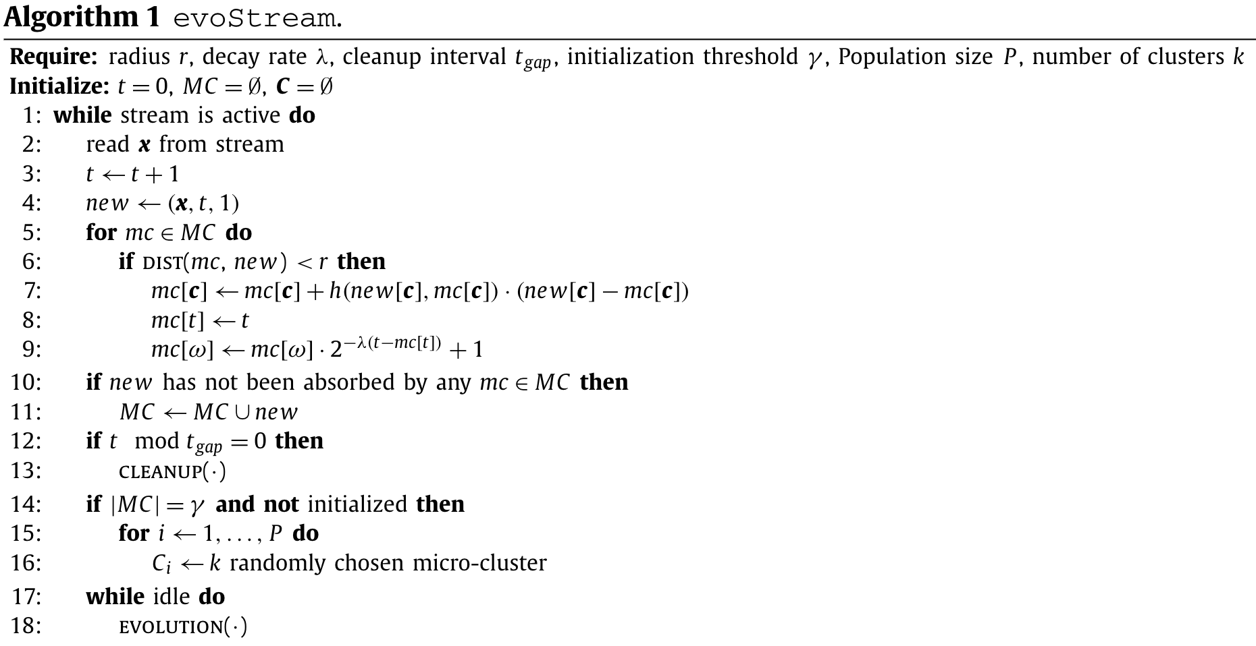
EVOstream algorithm #1
The algorithm processes samples as they arrive and forms micro-clusters (standard data stream clustering concept) in rows 1-16.
Instead of a post processing second phase, the algorithm performs evolutionary steps when idle in rows 17-18.
Theoretically, they could have used any micro-clustering strategy for the online phase.
Notes:
שני חלקים

Slide 22
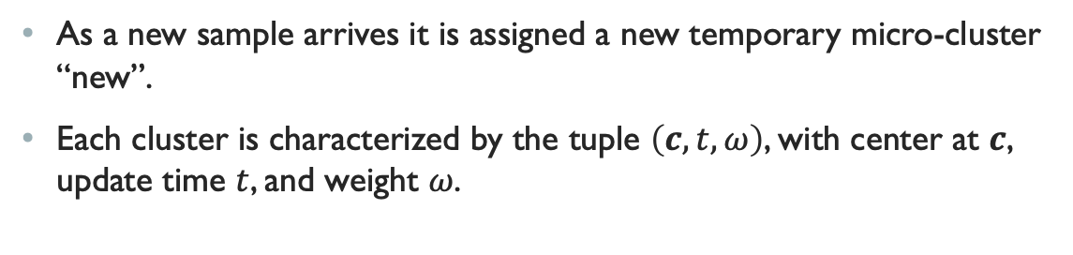
EVOstream algorithm #2
As a new sample arrives it is assigned a new temporary micro-cluster “new”.
Each cluster is characterized by the tuple $\left(c,t,ω\right)$, with center at $c$, update time $t$, and weight $ω$.
Notes:
בונים micro-cluster לכל דגימה

Slide 23
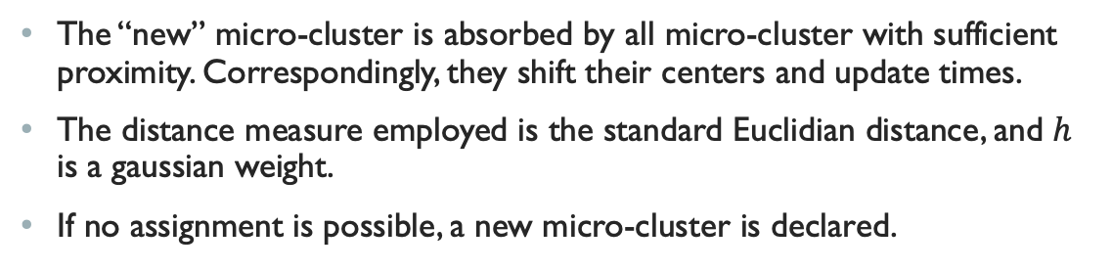
EVOstream algorithm #3
The “new” micro-cluster is absorbed by all micro-cluster with sufficient proximity. Correspondingly, they shift their centers and update times.
The distance measure employed is the standard Euclidian distance, and $h$ is a gaussian weight.
If no assignment is possible, a new micro-cluster is declared.
Notes:
בליעה לתוך clusters קיימים אם יש מישהו קרוב.
Aging

Slide 24
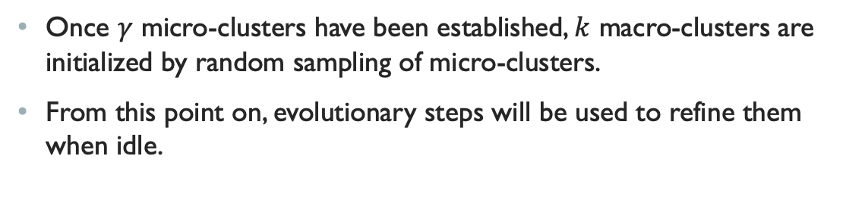
EVOstream algorithm #4
Once $γ$ micro-clusters have been established, $k$ macro-clusters are initialized by random sampling of micro-clusters.
From this point on, evolutionary steps will be used to refine them when idle.
Notes:
איתחול – macro-clusters, ואבולוציה

Slide 25
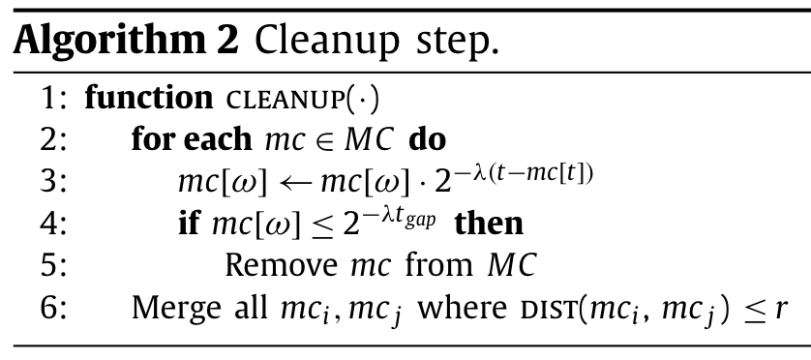
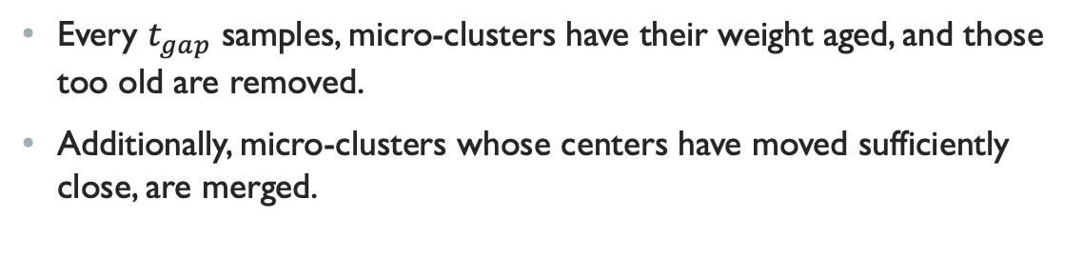
EVOstream algorithm #5
Every $t_{gap}$ samples, micro-clusters have their weight aged, and those too old are removed.
Additionally, micro-clusters whose centers have moved sufficiently close, are merged.
Notes:
מדי פעם מנקים micro-clusters ישנים.
איחוד קרובים

Slide 26
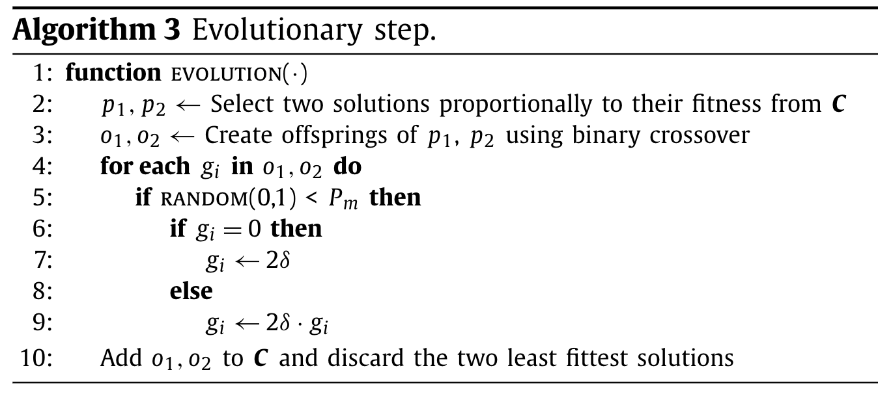
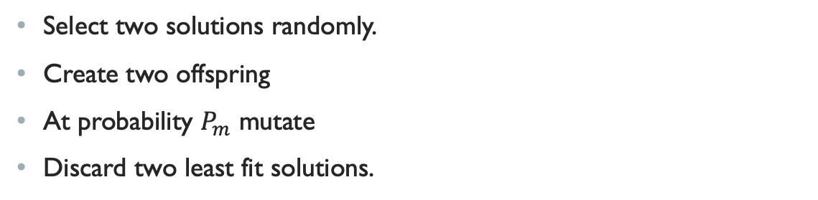
EVOstream algorithm #6
Select two solutions randomly.
Create two offspring
At probability $P_{m}$ mutate
Discard two least fit solutions.
Notes:
מדי פעם מנקים micro-clusters ישנים.
איחוד קרובים

Slide 27
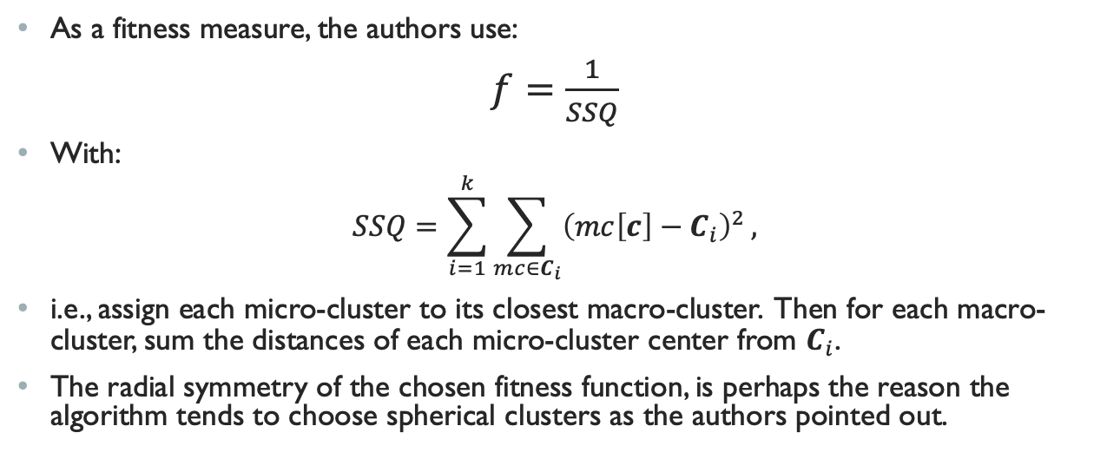
EVOstream algorithm #7
As a fitness measure, the authors use:
$f=\frac{1}{SSQ}$
With:
$$SSQ=\sum_{i=1}^{k}{\sum_{mc∈C_{i}}{{\left(mc\left[c\right]−C_{i}\right)}^{2}}},$$
i.e., assign each micro-cluster to its closest macro-cluster. Then for each macro-cluster, sum the distances of each micro-cluster center from $C_{i}$.
The radial symmetry of the chosen fitness function, is perhaps the reason the algorithm tends to choose spherical clusters as the authors pointed out.
Notes:
מידה ראדיאלית, מעדיפה מרכזים עגולים.

Slide 28
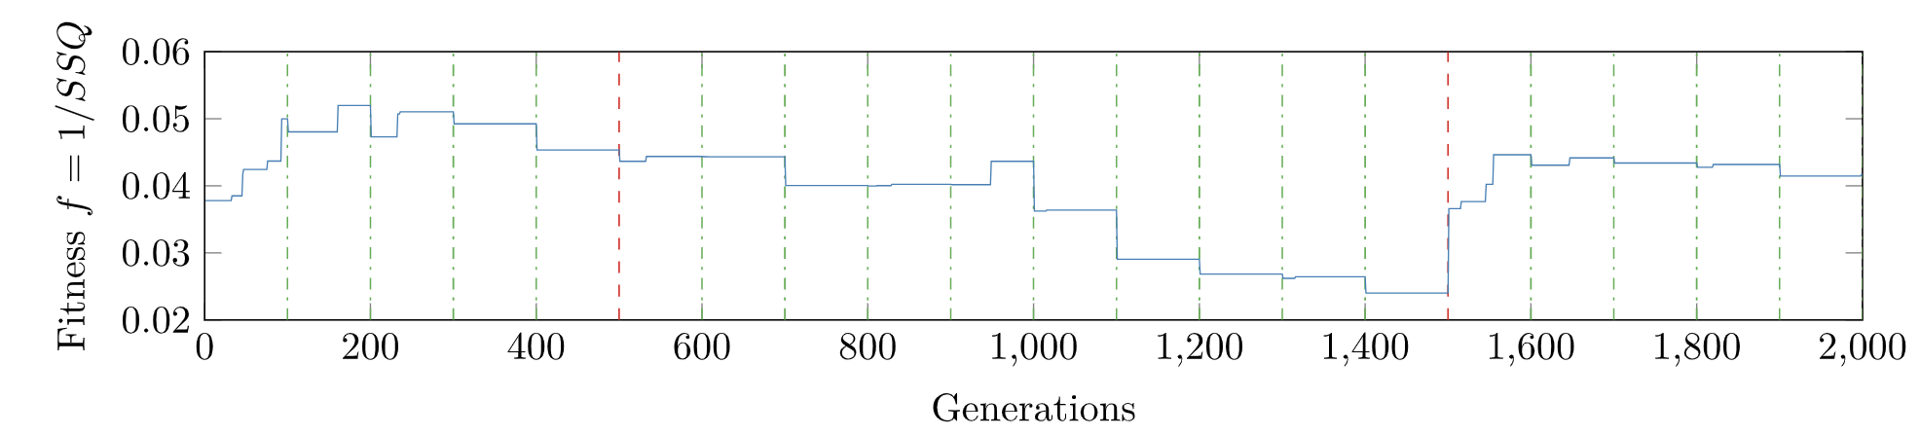
EVOstream algorithm –results #1
As an initial test, the authors ran the algorithm on two Gaussian clusters.
The point worth noting the the the non- monotonous changes to fitness across generations.
As new micro-clusters are added (green lines), fitness tends to fall.
On the other hand, clean-up steps (red-lines), always improve the fitness.
This is a consequence of the fitness not being normalized by the number of samples.
Notes:
הרצה על גאוסיאנים.
שינוי לא מונוטוני
נובע מהעובדה ש- f לא מנורמל בכמות ה- micro –clusters.

Slide 29
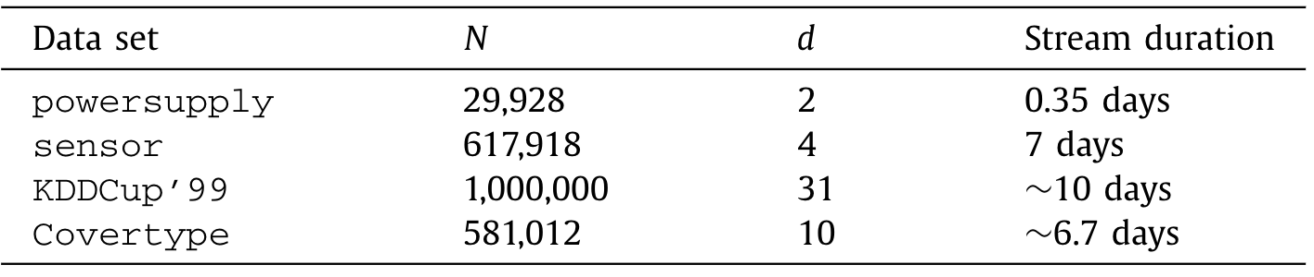
EVOstream algorithm –results #2
To evaluate the algorithm, it was run on several public data sets:
Powersupply – is a dataset of hourly power supply readings of an Italian electric company. Features are power supply to two seprate grids.
Sensor – is a dataset of physical sensor readings ( temperature, humidity, etc.).
KDDCup99 – is a dataset of network traffic data
Covertype – contains cartographic data.
Notes:
מספר סוגי מידע

Slide 30
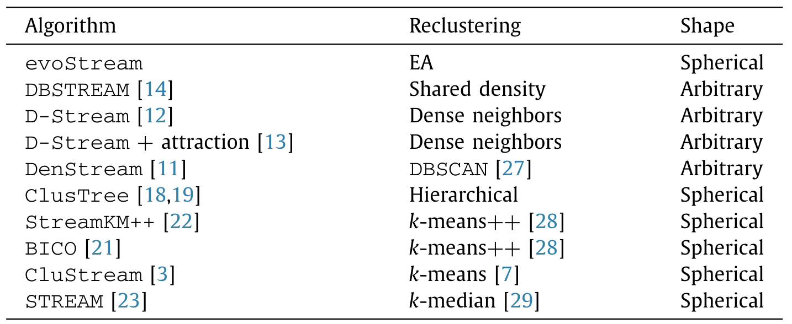
EVOstream algorithm –results #3
The authors benchmark their algorithm against multiple data stream clustering algorithms. Some are feature based while others are density based.
Note that some of them tend towards spherical clusters, while others do not.
Notes:
השוואה עם אלגוריתמים שונים. שימו לב לב להעדפה לעיגולים.

Slide 31
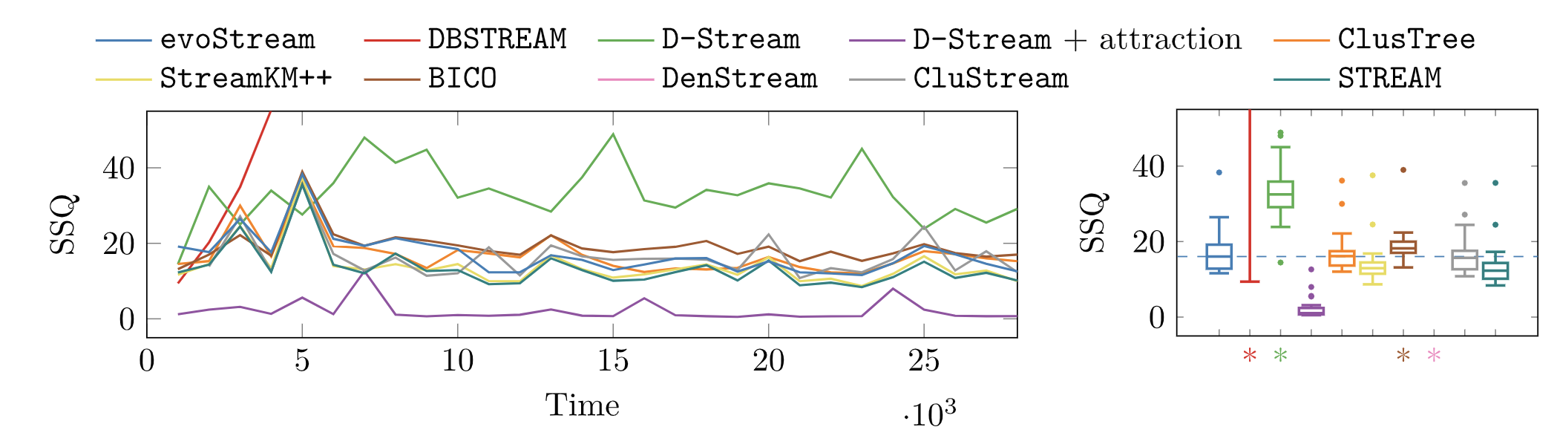
EVOstream algorithm –results #4
Below is a comparison between various algorithms when run against the power supply dataset.
The evoStream algorithm has a lower median SSQ compared to 4 of the algorithms.
The best in class is the D-Stream+attraction.
These results are somewhat unfair in my eyes. The authors measure the performance according to the metric that their algorithm tries to minimize. I would expect them to be best in class.
Note that the only algorithms which perform worse have no tendency towards spherical clusters maybe they aren’t.
They claim they tried also other performance metrics and found the same results.
Notes:
השוואת ביצועים. נראה שהיעצועים סבירים, אבל לא עדיפים.
זה מפתיע, כי המדד הוא הוא הגודל שממזערים.

Slide 32
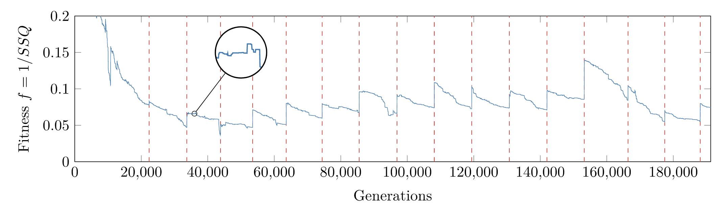
EVOstream algorithm –results #5
Using the same data set, but this time letting it run on the whole stream, shows a quick descent in fitness until first cleanup.
Following, during each clean-up fitness improves, and then degrades.
Generally, evolution creates an uptrend in fitness. The authors give no explanation regarding the following decline.
Again, given the fact that the fitness isn’t normalized by the number of samples of micro-clusters, it is hard to judge the quality of clustering as samples arrive.
Notes:
הפעם על כל הדאטא.

Slide 33
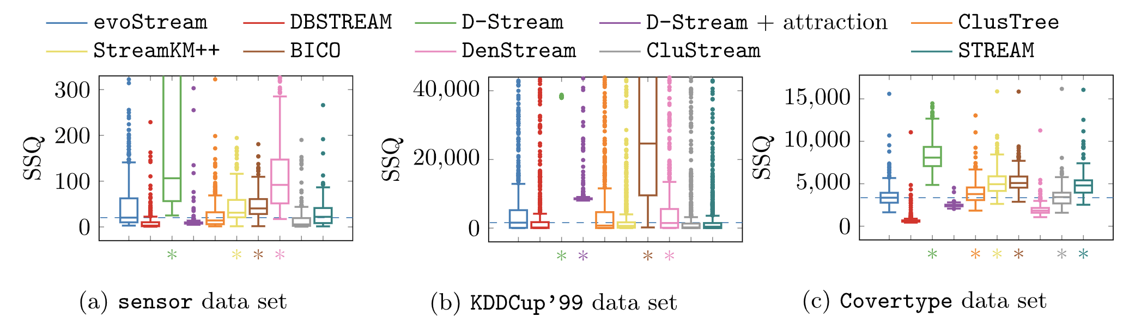
EVOstream algorithm –results #6
Same comparison but for other data sets.
Still no clear advantage for the evoStream algorithm.
As seen in the left bar of each plot, for the sensor data set, variance in the SSQ is larger.
This is a result of the fact that this dataset is faster, and here’s less time for iterations.
Notes:
ואריאנס גדול משמאל.
כי הדאטא מהיר.

Slide 34
EVOstream algorithm – summary
The algorithm is able to provide results with comparable quality to other common algorithms.
It does so while requiring less computational power, and is able to improve results incrementally, thus providing results on demand.
It seems using a fitness function which isn’t normalized by the number of micro-clusters hurts overall results, as well as making it harder to measure the actual performance.

Slide 35
My Motivation

Slide 36
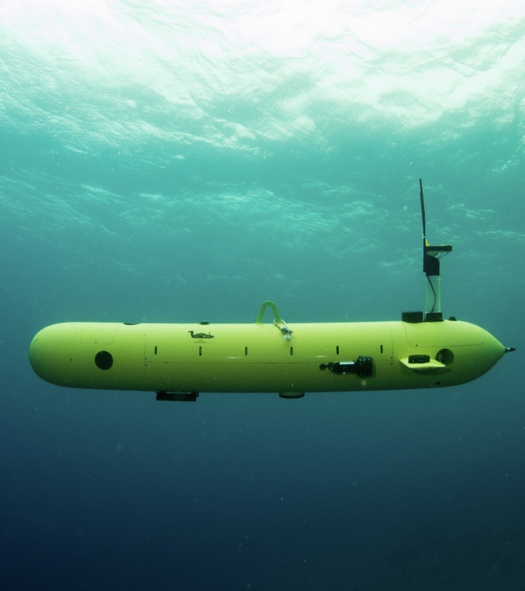
Back Story
I work in LAR on the HC200
The HC200 uses acoustic communication to trasmit telemetry while submerged.
Communication is relatively unreliable:
Limited abilty ot retransmit
Limited bandwith , challenging channel

Slide 37
Concept
The HC200 is an example of an autonomous platform, which continuously transmits telemtry data.
Many sensors and autonomous platforms send such data continuously.
Data is often well structured and uses an apriori known protocol.
However, due to limitations of the channel, hardware, or other, communications may have low throughput and low link relaibility.

Slide 38
More examples
Low Throughput Comm.
Structured Telemetry Protocols
Acousitc communication
LORA
CAN BUS
MAVLink
ROS

Slide 39
What do I mean by structure?
The HC200 sends sensor data periodically.
The transmission follows a strict protocol (described later):
An apriori known list of possible messages.
Within each message, each byte has an apriori known meaning.
Most of the time what changes is only the payload.
Some of the data changes very slowly, for instance MSB’s of:
Position
Depth
Water temperature
Some of the data typically don’t change:
Protocol structure
Error flags

Slide 40
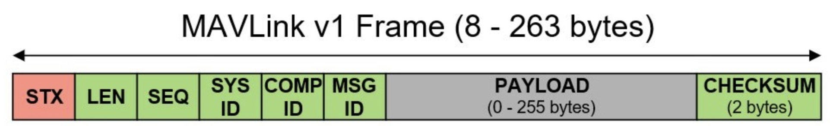
MAVLink Protocol
Each transmission includes several serialized messages.
A message has a following structure:
Constant start byte
Length byte
A running sequence number byte
System ID (sender address)
Component ID (sender’s component)
Message ID (message number)
Payload data (length varies)
2 checksum bytes
Protocol Documentation: https://mavlink.io/en/
A survey:
Koubaa, Anis, et al. "Micro air vehicle link (mavlink) in a nutshell: A survey." IEEE Access 7 (2019): 87658-87680.

Slide 41
What type of structure can we expect?
Mostly the same messages are serialzed over and over along a mission. These may changes bwetween missions or experiments.
Thus protocol dictated bytes in the stream are expected to remain mostly constant across sequetial transmissions.
MSB’s of phsyical quantities are expected to change slowly or not change at all across sequetial transmissions.

Slide 42
Why do we care?
If structure is inferred, it can improve communication relability without consuming additional channel resources.
Learned bits can help do channel decoding without additional overhead.

Slide 43
Current status & future workplan
Current:
As of today after channel decoding, if transmission fails the checksum, inferred structure bits are imposed on the stream.
Afterwhich, checksum calculation is again attempted.
Goals:
Improve structure / pattern identification – Attempt clustering of incoming data stream.
Better integrate the knowledge into the channel decoding scheme.

Slide 44
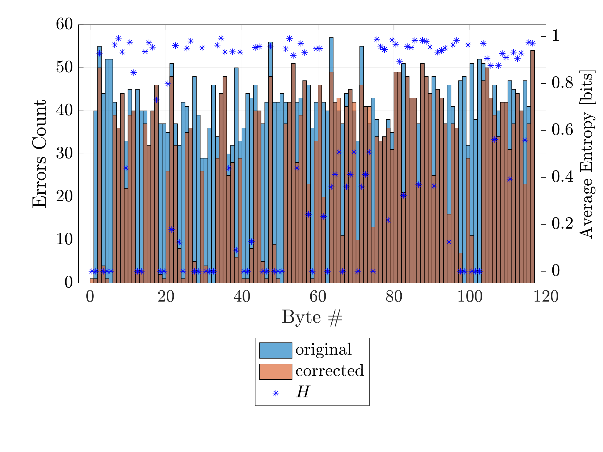
Current results
Entropy of bits along tranmission is calculated.
Low entropy bits are deemed structural.
Up to 4% of corruted messages receovered.
Above 30% of bit error corrected.

